Slide 1
Data ingestion using Azure Data Factory
Use ADF to ingest data from a relational database to Azure datalake
- Lipsa

Slide 2
Azure Data Factory
ADF a completely managed server less service
ADF is used in following scenarios:
1. Data ingestion
2. Basic transformation
3. Orchestrations

Slide 3
Task
Task – Transfer data from a RDBMS table to a data lake using ADF
Source – Azure SQL Database as RDBMS table
Sink – ADLS Gen 2

Slide 4
Resources to be used
Resource group
Storage account (Data lake)
Azure Data factory
Azure SQL database (Source)
Linked service for source
Linked service for sink
Dataset for source
Dataset for sink
A copy activity
Pipeline

Slide 5
Resource Group

Slide 6
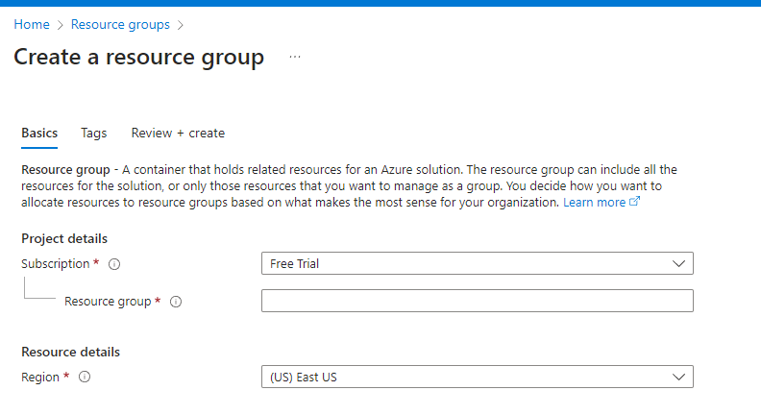
Creation of Resource group
Details:
Subscription – Free trial
Resource group -Lipsa-ResourceGroup-1
Region –(Asia Pacific) Central India

Slide 7
Azure SQL Database

Slide 8
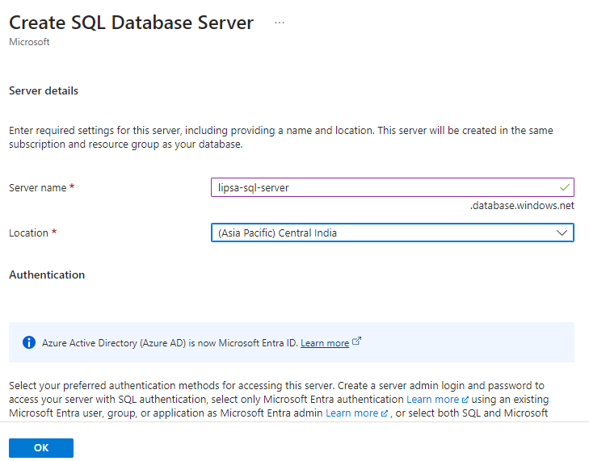
Creation of Azure SQL database server
Details:
Server name - lipsa-sql-server
Location – (Asia Pacific) Central India
Authentication method – Use SQL authentication
Server admin login – scott
Password -

Slide 9
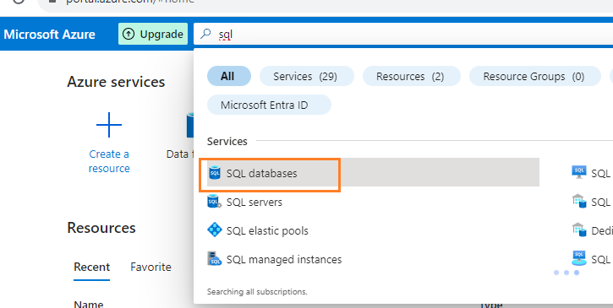
Creation of Azure SQL database

Slide 10
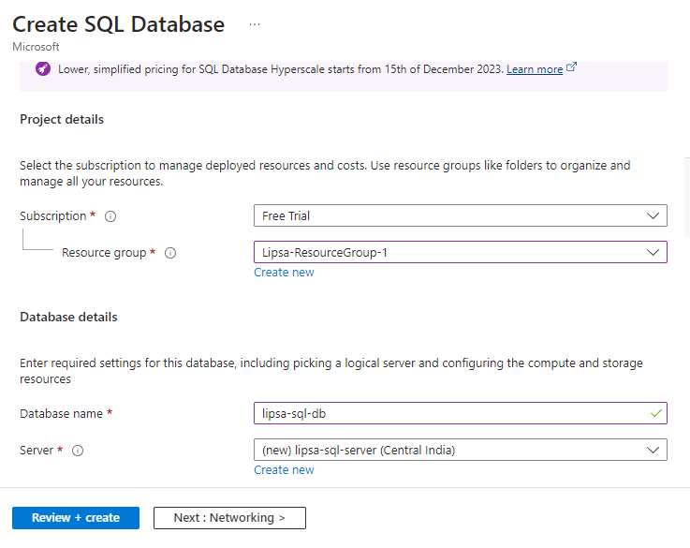
Creation of Azure SQL database
Details:
Subscription – Free trial
Resource group – Lipsa-Resourcegroup-1
Database name- lipsa-sql-db
Server – lipsa-sql-server
Backup storage redundancy
-Locally-redundant backup storage

Slide 11
Creation of Azure SQL database
Details:
Subscription – Free trial
Resource group – Lipsa-Resourcegroup-1
Database name- lipsa-sql-db
Server – lipsa-sql-server
Backup storage redundancy
-Locally-redundant backup storage

Slide 12
Enable firewall
Add your client IP
Allow Azure service

Slide 13
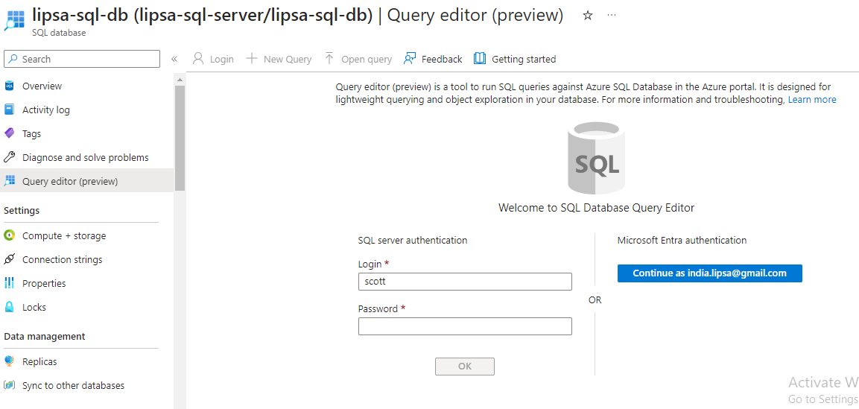
Open query editor
Login

Slide 14
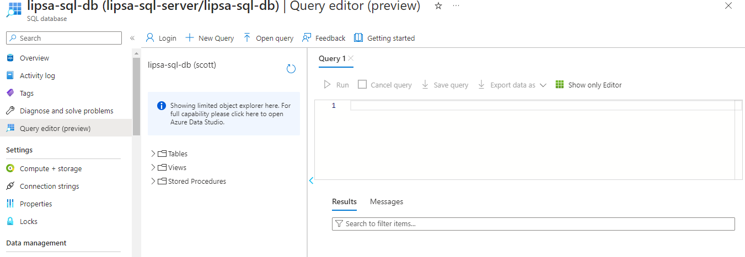
Open query editor
Login

Slide 15
Create table and insert data
create table courses
(course_id int NOT NULL,
course_name varchar(30) NOT NULL,
course_duration_months int NOT NULL,
course_fee int NOT NULL,
PRIMARY KEY(course_id));
insert into courses values(1,'bigdata',6,50000);
insert into courses values(2,'webdevelopment',3,20000);
insert into courses values(3,'datascience',6,40000);
insert into courses values(4,'devops',1,10000);

Slide 16
ADLS Gen 2 (Data lake)

Slide 17
Create ADLS Gen2
Create a storage account – ADLS Gen2
Create a container inside the storage account
create directory “coursesdata”

Slide 18
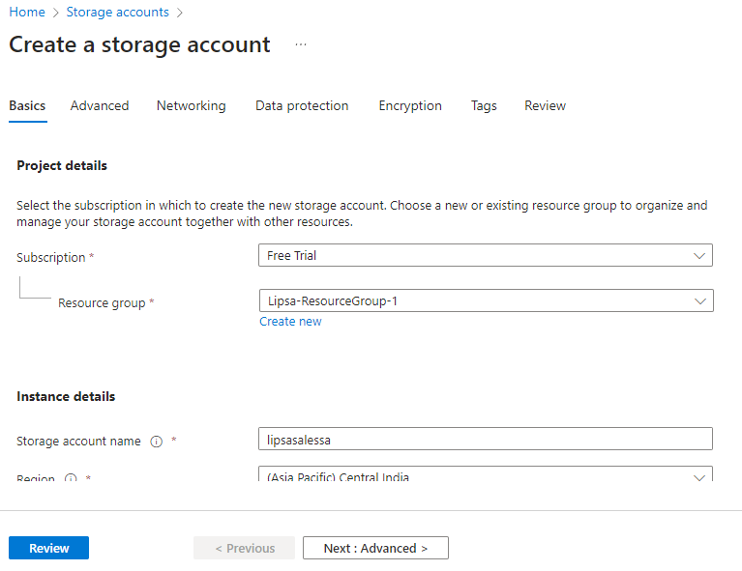
Create Storage account
Subscription- Free trial
Resource group – Lipsa-ResourceGroup-1
Storage account name –lipsasalessa
Region – Central India
Performance – Standard
Redundancy – Locally redundant storage
Advanced
Hierarchical Namespace
Enable hierarchical namespace

Slide 19
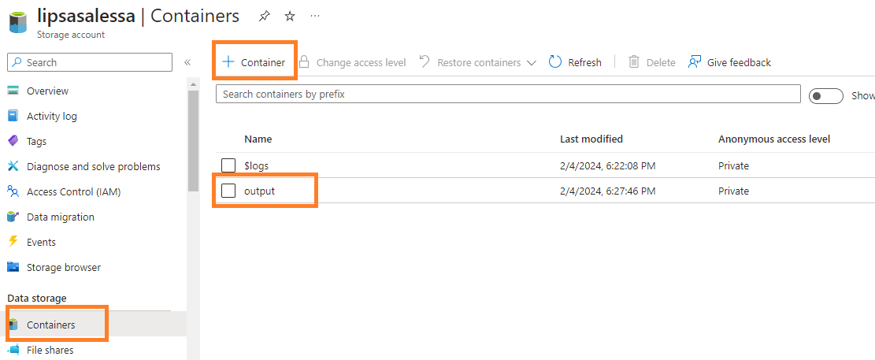
Create container inside storage account

Slide 20
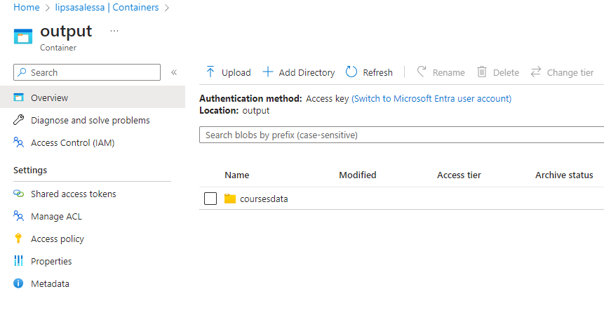
Create directory inside container

Slide 21
ADLS Data factory

Slide 22
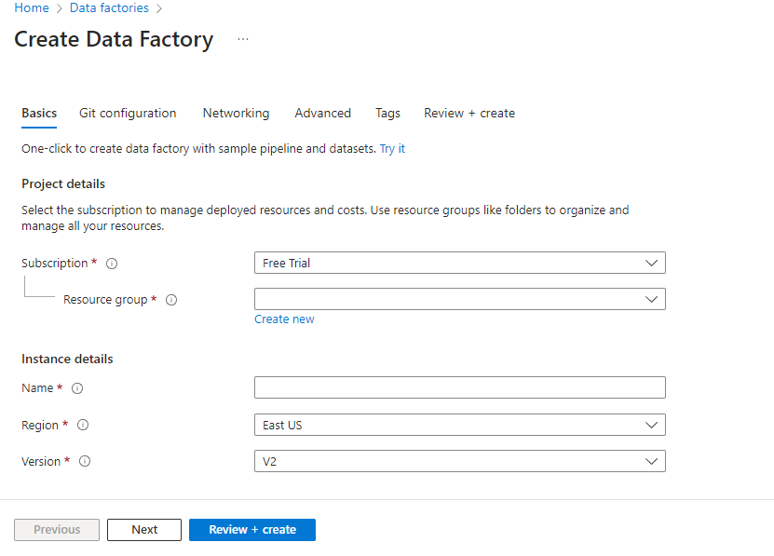
Create Azure data factory
Subscription – Free trial
Resource group - <>
Name – lipsasalesdf
Region – Central India
Version – V2

Slide 23
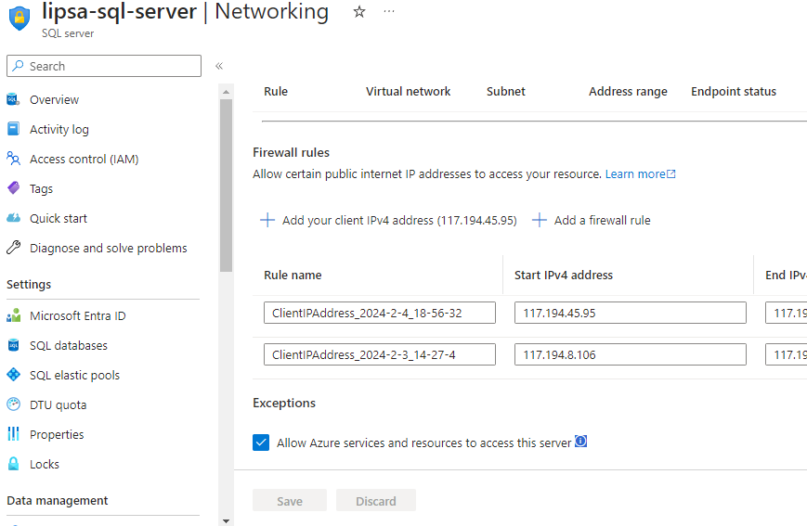
Allow Azure service and resources to access

Slide 24
Linked services

Slide 25
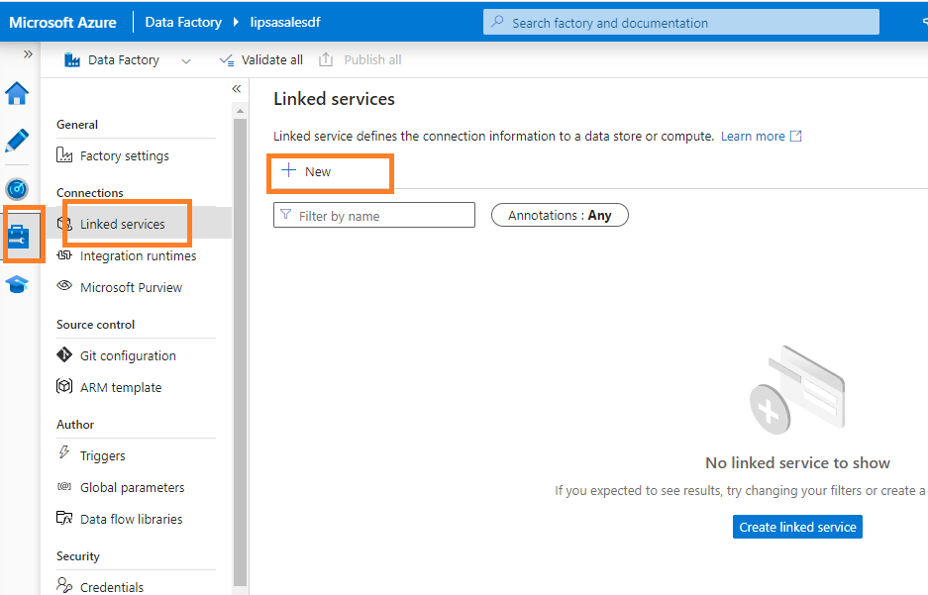
Create Linked services
Linked service to SQL DB
Linked service to ADLS Gen2

Slide 26
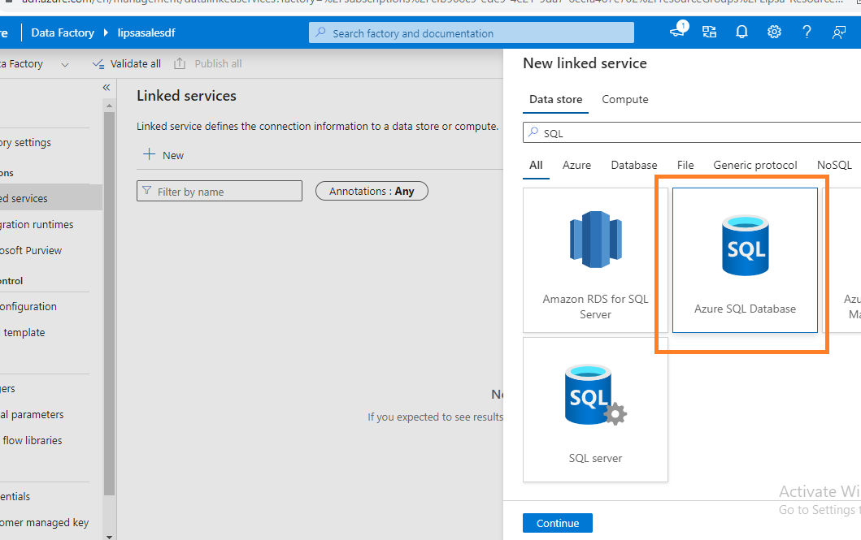
Linked service to SQL DB

Slide 27
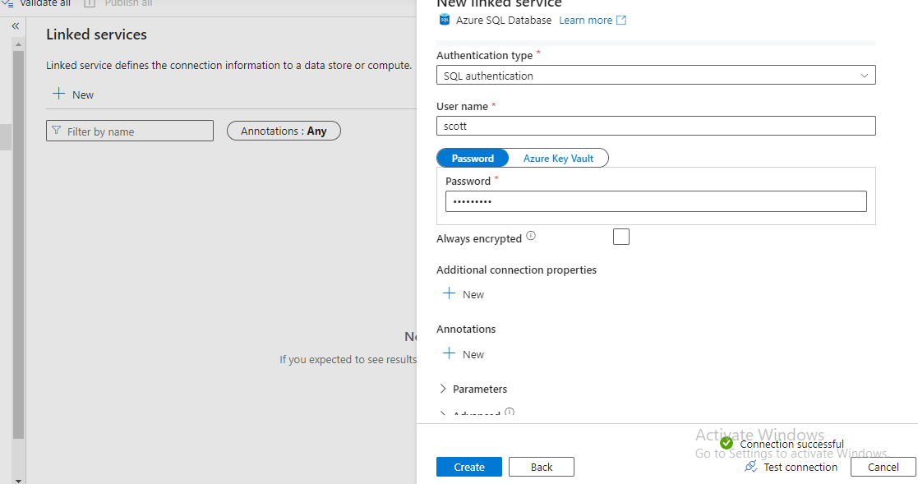
Linked service to SQL DB

Slide 28
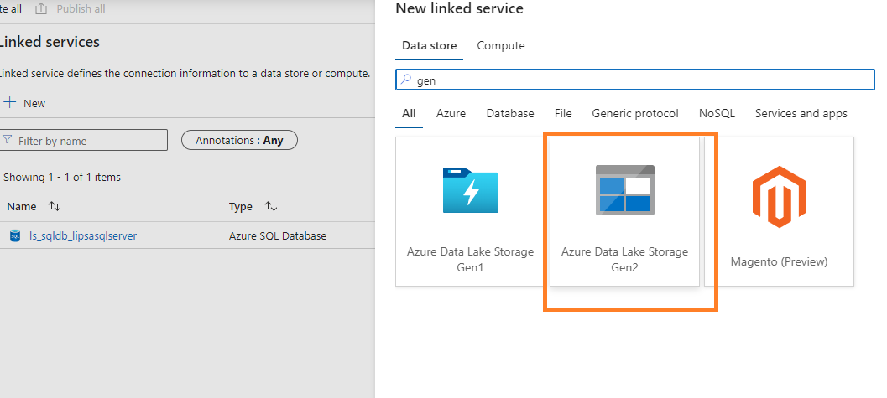
Linked service to ADLS Gen 2

Slide 29
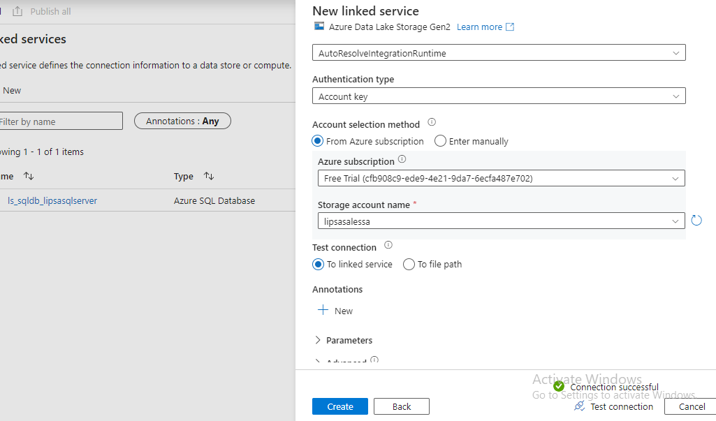
Linked service to ADLS Gen 2

Slide 30
Datasets

Slide 31
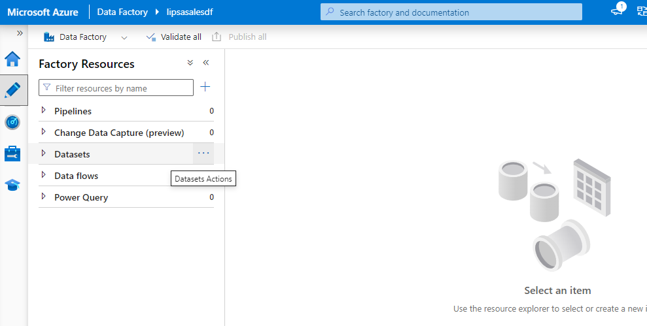
Create datasets for source and sink

Slide 32
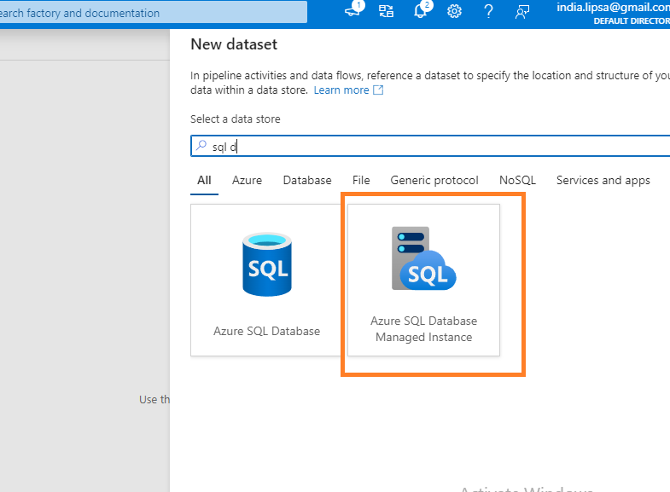
Create datasets for source – SQL database

Slide 33
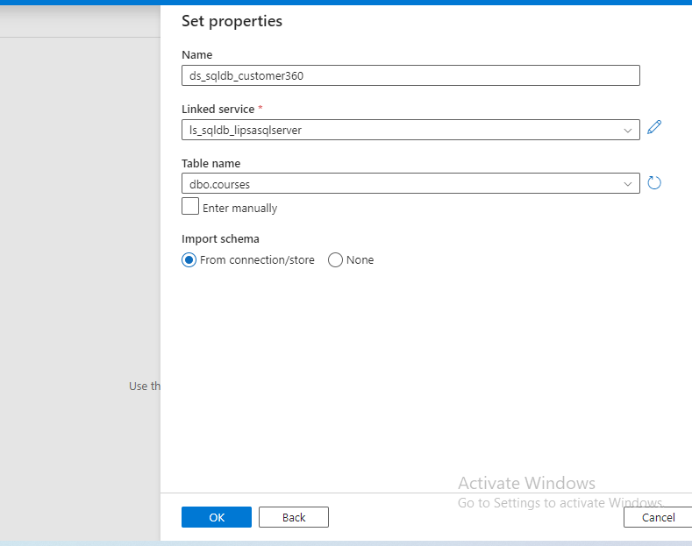
Create datasets for source – SQL database

Slide 34
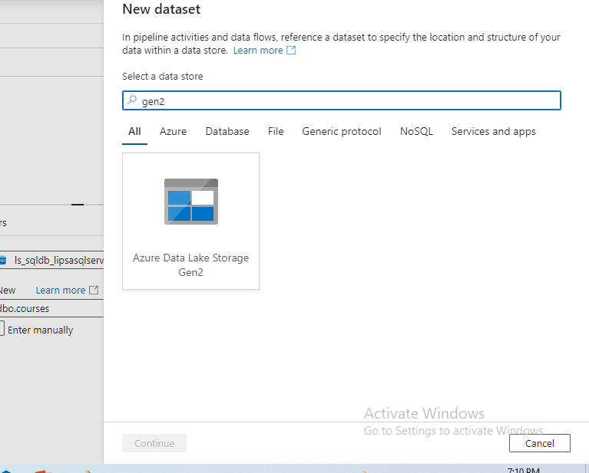
Create datasets for sink– Datalake gen2

Slide 35
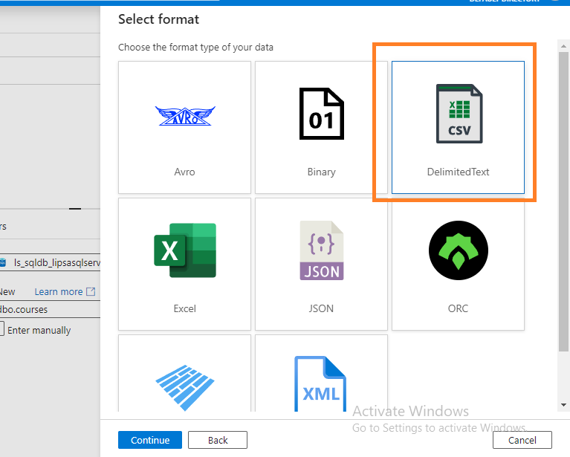
Create datasets for sink– Datalake gen2

Slide 36
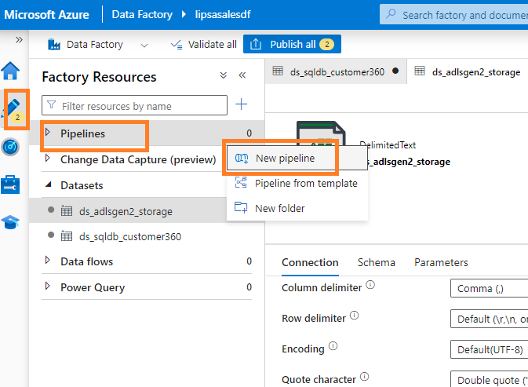
Create pipeline to do copy activity

Slide 37
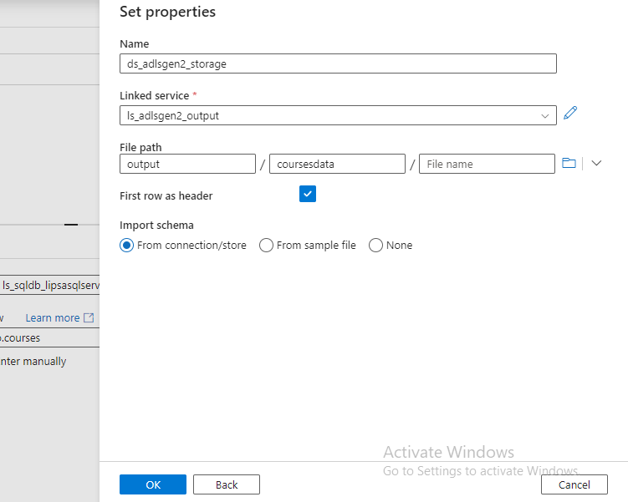
Create datasets for sink– Datalake gen2

Slide 38
Pipeline

Slide 39
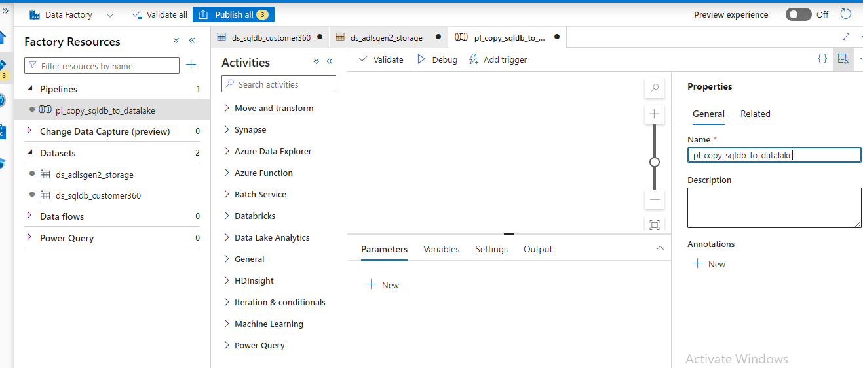
Create pipeline to do copy activity

Slide 40
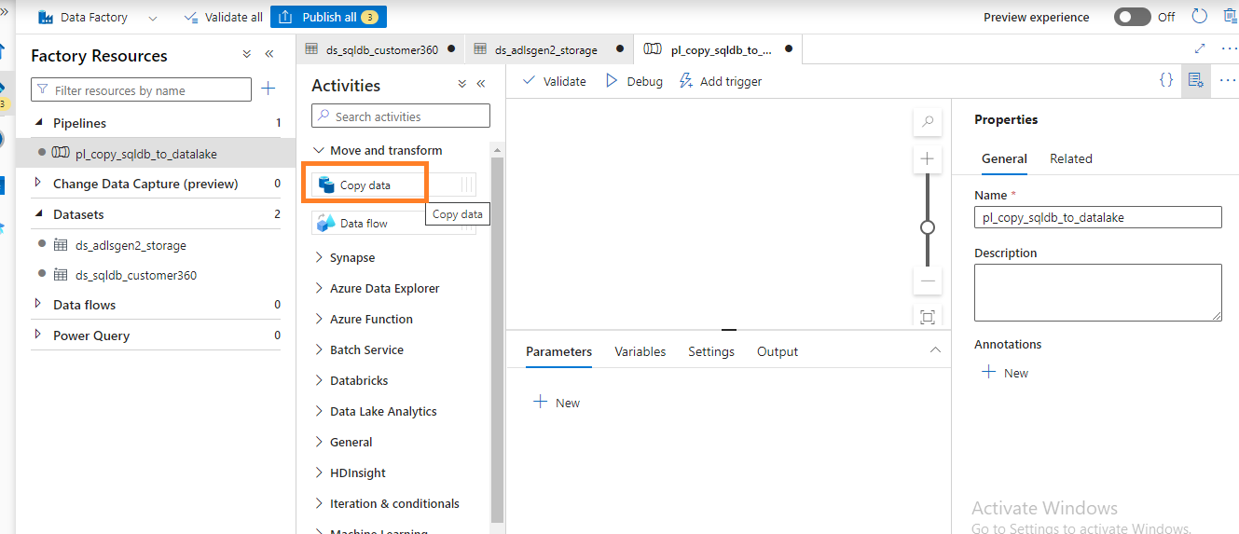
Create pipeline to do copy activity

Slide 41
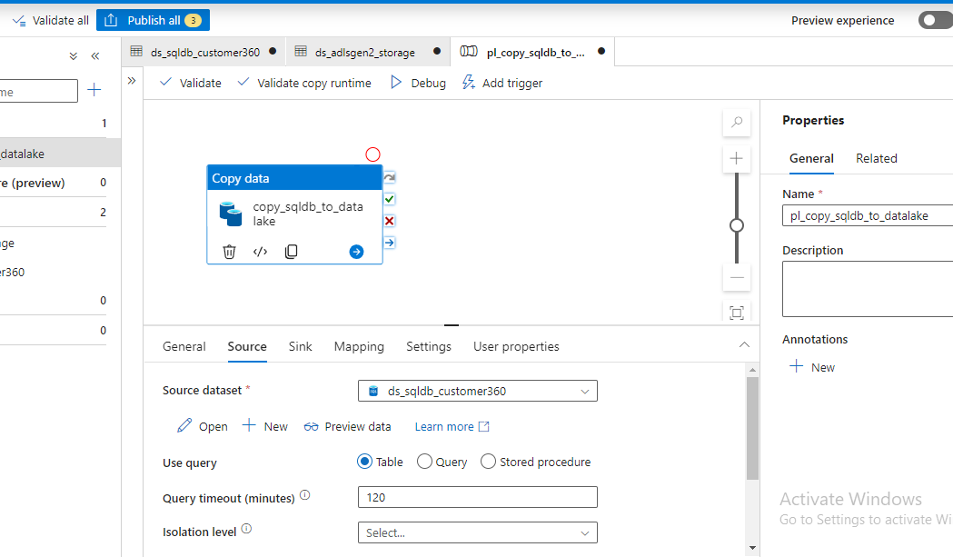
Create pipeline to do copy activity

Slide 42
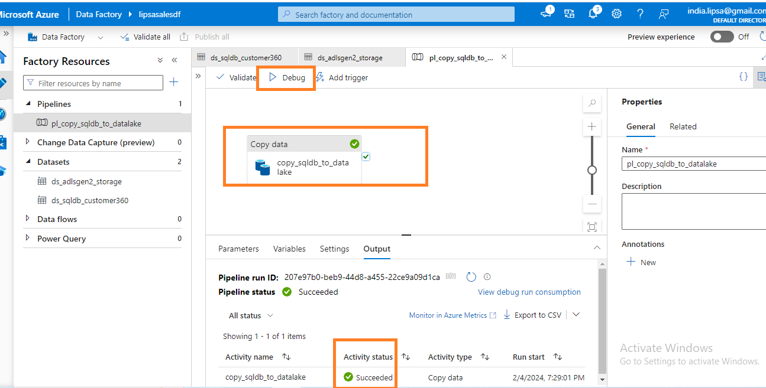
Debug pipeline

Slide 43
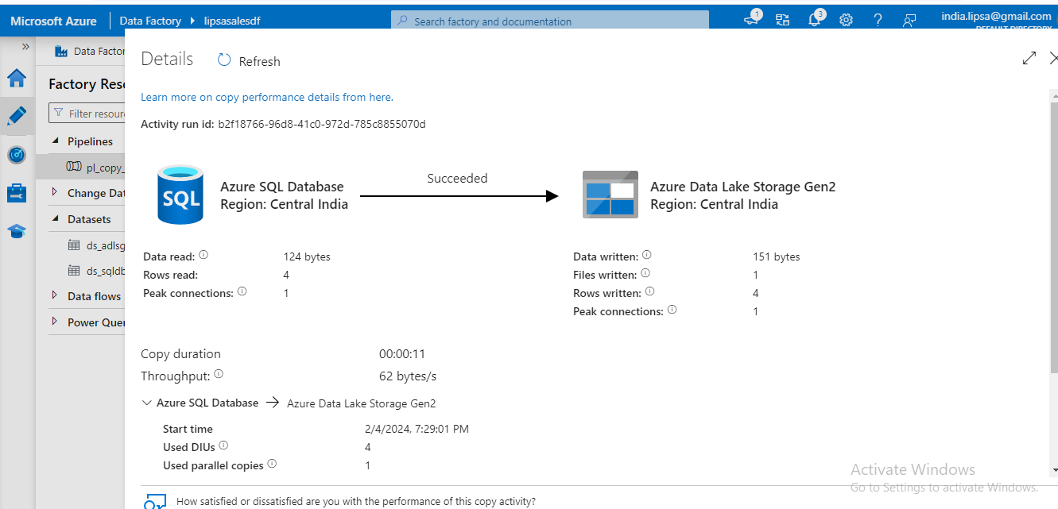
Output of pipeline

Slide 44
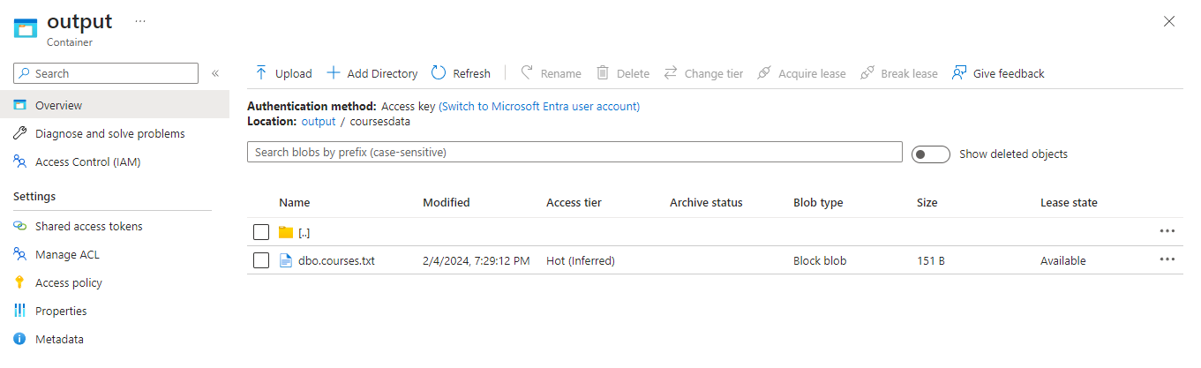
Output of pipeline

